Slide 1
CUSTOMER CHURN ANALYSIS USING POWERBI
Overview
What is Customer churn? This is essentially the rate at which customers leave a business against the total customers that are actively in business. This is also known as churn rate.

Slide 2
Project Objective: The problem at hand is to analyze customer churn for a telecommunications company. The company is experiencing a high rate of customer churn, resulting in significant revenue loss. The management wants to identify the key factors contributing to customer churn and develop strategies to reduce churn rate and increase customer retention. Tools: I used Power BI and Power Query for this analysis.

Slide 3
About the data The raw data was provided in the form of a EXCEL WORKSHEET with 10,000 rows of data. Data was sourced from a TELECOMMUNICATION COMPANY who was looking to improve its customer churn rate. The outcome of this project will enable the telecommunications company to gain a deeper understanding of customer churn and develop data-driven strategies to improve customer retention. The insights derived from the analysis will guide decision-making processes and aid in the development of targeted retention programs, leading to increased customer satisfaction and reduced revenue loss due to churn.

Slide 4
DATASET To create a dataset for customer churn analysis in a telecommunications company, we can include various relevant features that capture customer information, service usage, contract details, and churn status. Here's an example of a dataset that can be used for customer churn analysis 1. Customer ID A unique identifier for each customer. 2. Gender The gender of the customer (Male/Female). 3. Age The age of the customer. 4. Marital Status Whether the customer is married or single. 5. Dependents The number of dependents the customer has. 6. Contract Type The type of contract the customer has (e.g., monthly, yearly). 7. Internet Service The type of internet service the customer has subscribed to (e.g., DSL, fiber optic). 8. Phone Service Whether the customer has a phone service or not. 9. Multiple Lines Whether the customer has multiple phone lines or not. 10. Online Security Whether the customer has opted for online security services. 11. Online Backup Whether the customer has opted for online backup services. 12. Device Protection Whether the customer has opted for device protection services. 13. Tech Support Whether the customer has opted for technical support services. 14. Streaming TV Whether the customer has subscribed to streaming TV services. 15. Streaming Movies Whether the customer has subscribed to streaming movie services. 16. Monthly Charges The monthly charges for the customer's services. 17. Total Charges The total charges incurred by the customer. 18. Churn Status Whether the customer has churned or not (Yes/No).

Slide 5
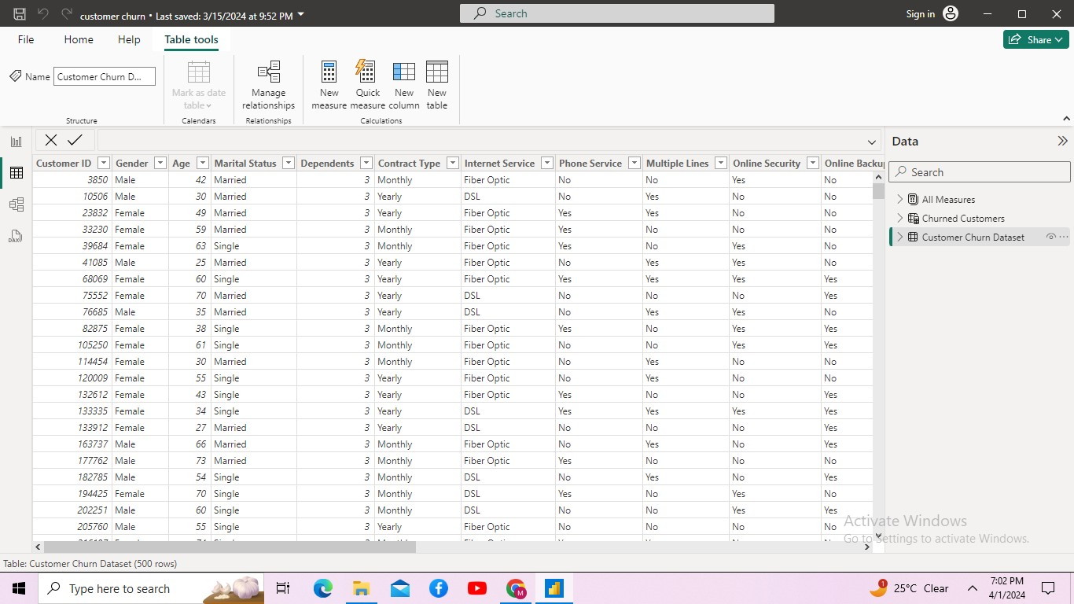
DATA DISCOVERY

Slide 6
I opened the data in excel and inspected the columns for relevance to the business task (This can equally be done directly on Power Query), I was able to confirm that there is sufficient data to aid my analysis. However, data needed to be cleaned and properly transformed in the format that would be useful for the analysis. Analytical Steps Data Preparation Data Categorization and Grouping Formatting Data Transformation Data Modeling Visualization — Report Insights Recommendation Conclusion

Slide 7
Data Preparation I imported the data into Power BI and transformed it on Power Query as follows: I renamed the data from customer churn data to Customer Data for clarity. The new name better captures what the content of this file is. . Next, I eliminated the auto-generated header, by promoting the first row of my data to become the header. The option for this can be found on both the home tab and the transform tab of Power Query Editor.

Slide 8
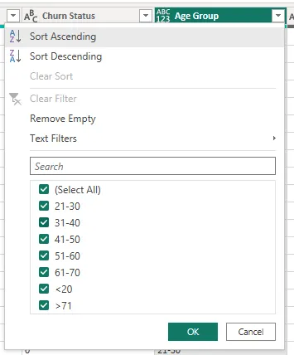
Data Transformation Here, I created Queries to organize data for better analysis and reporting. Because I had grouped some of these columns used symbols like <, >=, etc, and changed the groups to them to text data type, I was not able to filter it successfully in ascending or descending order. This is because the system would place all the groups with numbers only first, before the ones with symbols as shown below.

Slide 9
Next, I removed duplicate rows leaving behind only the distinct values that I would index. Since it was a custom sorting, I selected the conditional column option and entered the conditions as desired. I then changed the data type of the index columns to whole numbers. I clicked on close and apply which loaded the cleaned data (see below) onto the Power BI window.

Slide 10
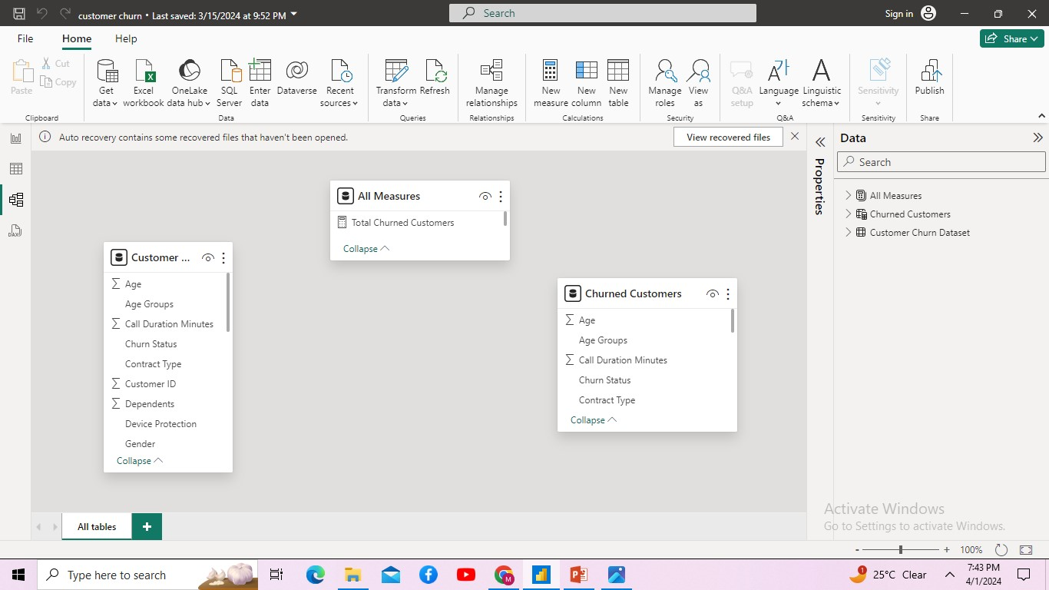
Data Modelling

Slide 11
6. Visualization — Report I started the report by creating a few DAX measures. DAX simply means Data Analysis Expression. It is an expression that helps with calculations while building report. The three I created were: Customers(Number of customers) Churn rate (%) Customers Churned Step:
On the right pane where the tables are listed, I right clicked on the Customer Data table, then selected new measure. I labeled the measure as Customers and used the formula below.
Customers = DISTINCTCOUNT('Customer Data'[Customer ID])
This formula above counted all the unique ID in the Customer ID column.
I repeated the above steps for the Customers Churned and Churn Rate measure with the respective formulas' below:
Customers Churned = CALCULATE(COUNT('Customer Data'[Churn Status]), 'Customer Data'[Churn Status] = "churned") Churn Rate = 'Customer Data'[Customers Churned]/'Customer Data'[Customers]

Slide 12
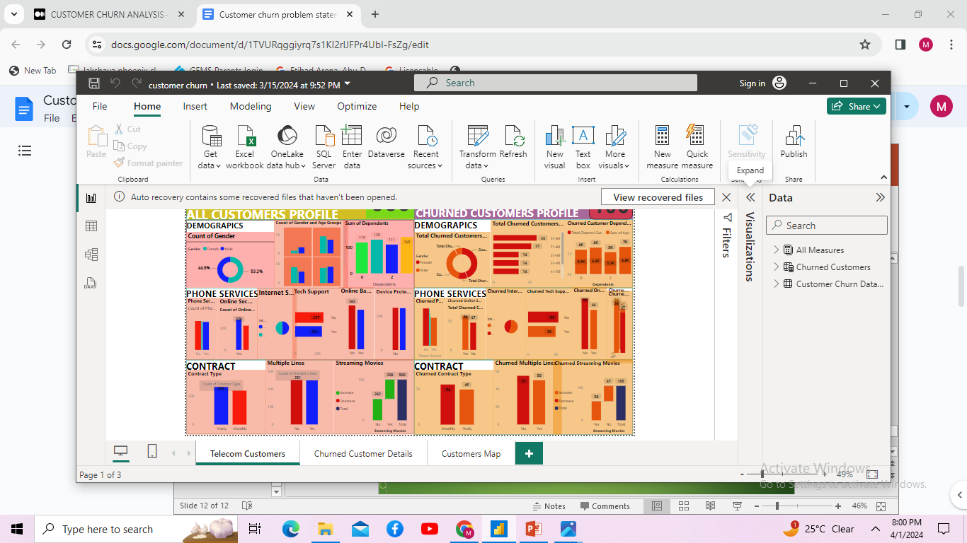
finally, I built the report AS DIVIDED INTO PARTITION AS ALL CUSTOMER PROFILE AND CHURN CUSTOMER PROFILE, in the screenshot below, taking into account the key factors like CUSTOMER ID, age, MARITAL status, gender, DEPENDENTS, CONTRACT TYPE, INTERNET SERVICE,PHONE SERVICE, MULTIPLE LINES, ONLINE SECURITY,BACKUP SERVICE, STREAMING TV, STREAMING MOVIES, MONTHLY CHARGES, TOTAL CHARGES etc.. and their effects on the churn rate..

